Slide 1

Lab 7 - Simon Lab
Write a MSP430 assembly language program to play the game of Simon.
  Each round of the game is started by flashing the LEDs several times.
  Flash the colored LEDs (along with the associated tones) one at a time in a random sequence.
  Sample the push button switches and count the number of colors (tones) correctly entered in the same order as the original sequence.
  Continue until the end of the sequence is reached or a mistake is made.
  Play some congratulatory tune if the sequence is correct or some raspberry sound if a mistake is made.
  If the sequence is successfully reproduced, restart the game adding one more color/tone to the sequence. Otherwise, restart a new sequence.
Use Timer_B output (TB2) to PWM the speaker tones.

Slide 2
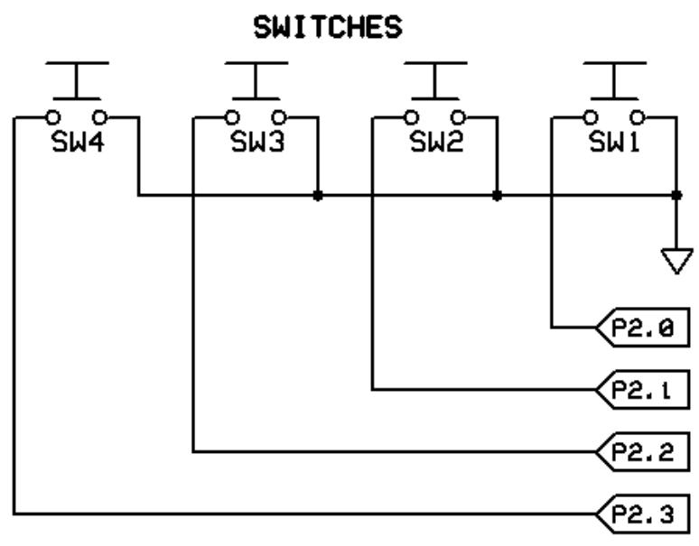
Switches
Switch Debounce
Switches
  Port 2, bits 0-3
  Use internal pull-ups
  Require debouncing
  Interruptable
mov.b #0,&P2SEL ; select GPIO
bic.b #0x0f,&P2DIR ; configure P2.0-3 as inputs
bis.b #0x0f,&P2OUT ; use internal pull-ups
bis.b #0x0f,&P2REN ; enable pull-ups

Slide 3

Electronic Representation of a Bit
Switch Debounce
Relies only on approximate physical values.
  A logical ‘1’ is a relatively high voltage (2.4V - 5V).
  A logical ‘0’ is a relatively low voltage (0V - 1V).
Analog processing relies on exact values which are affected by temperature, age, etc.
  Analog values are never quite the same.
  Each time you play a vinyl album, it will sound a bit different.
  CDs sound the same no matter how many times you play them.

Slide 4
Switch Debounce
Switch Debounce
Switch Pressed
Switch Released
3.3
Logic "High"
2.4
Illegal
0.5
0.0
Logic "Low"
Switch "debounded" after signal remains low/high for specified time

Slide 5
Example 6: Switch Debounce
Switch Debounce
;**********************************************************************
; Get debounced switch in R12 (high to low transistion)
;
DB_TIME .set 10 ; 10 ms debounce time
DB_CYCS .set 12 ; instruction cycles for delay
DB_DELAY .set DB_TIME*myCLOCK/DB_CYCS/1000 ; delay count
get_debounced_switch:
push r15 ; callee save
deb02: mov.b &P2IN,r12 ; read switches
xor.b #0x0f,r12 ; SW1-4
and.b #0x0f,r12 ; any switch low?
jne deb02 ; y, wait for all high
deb04: mov.w #DB_DELAY,r15 ; minimum delay
deb06: mov.b &P2IN,r12 ; read switches
xor.b #0x0f,r12 ; SW1-4
and.b #0x0f,r12 ; all switches high?
jeq deb04 ; n, restart delay
dec.w r15 ; y, long enough delay?
jne deb06 ; n, keep going
pop r15 ; y, switches debounced
ret
Wait until all switches off
Return if R15 counts down to 0
Reset timing counter if and of the switches read 0

Slide 6
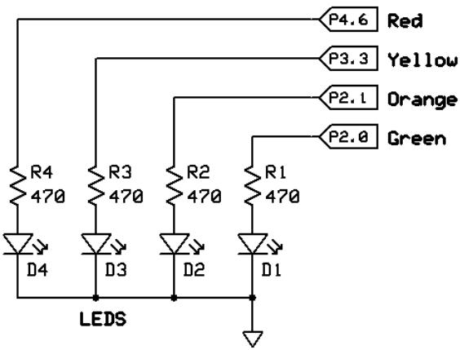
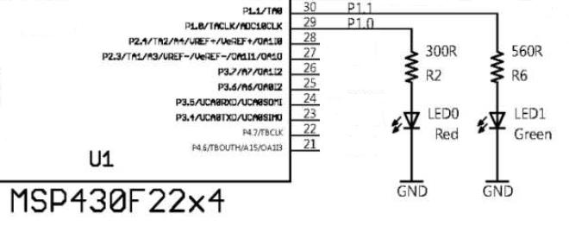
LED’s (Light Emitting Diode)
LED’s
LED’s
  P1.0, P1.1 on eZ430-F2500 board
  P2.0, P2.1, P3.3, P4.6
  0 = OFF, 1 = ON

Slide 7
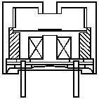
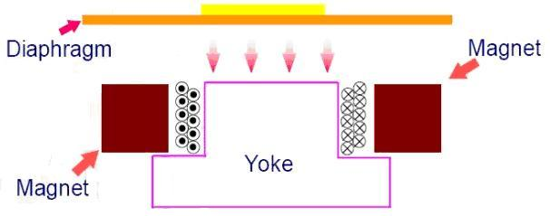
PWM: Tones w/Speaker
Pulse Width Modulation
Speaker output on P4.5 (Jumper B1)
Sound reproduction
  Carefully timed pulses
  Rely on a transducer’s physical filtering properties
  Very low quality
Use timer cycle (frequency) for tones
Use pulse width (duty-cycle) for volume

Slide 8
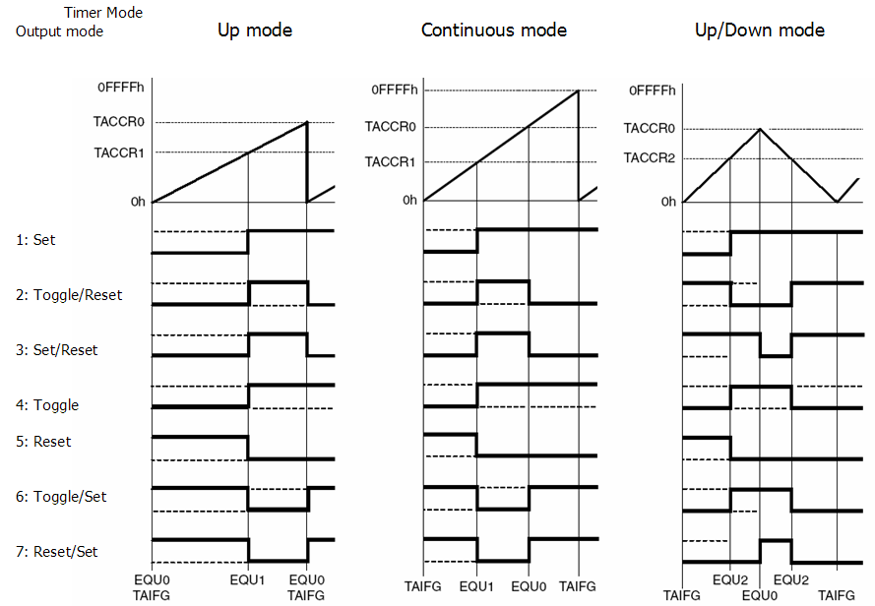
Timer_A/B Output modes
Pulse Width Modulation
Frequency
Duty Cycle
Ideal for PWM

Slide 9
TxCCTLx Control Register
Pulse Width Modulation
15 | 14 | 13 | 12 | 11 | 10 | 9 | 8 | 7 | 6 | 5 | 4 | 3 | 2 | 1 | 0
Capture Configuration |  |  |  |  |  |  |  | OUTMODx |  |  | CCIE | CCI | OUT | COV | CCIFG
Bit |  | Description
15-8 |  | Capture Configuration (Set to 0)
7-5 | OUTMODx | Output mode: 0 0 0 ⇒ bit OUT 0 0 1 ⇒ Set 0 1 0 ⇒ Toggle/Reset 0 1 1 ⇒ Set / Reset 1 0 0 ⇒ Toggle 1 0 1 ⇒ Reset 1 1 0 ⇒ Toggle / Set 1 1 1 ⇒ Reset / Set
4 | CCIE | Capture/compare interrupt enable when CCIE = 1.
3 | CCI | Capture/compare input
2 | OUT | Output state
1 | COV | Capture overflow when COV = 1
0 | CCIFG | Capture/compare interrupt flag CCIFG = 1 when interrupt pending
OUTMOD3 sets TB2 (P4.5) when TBCCR2 == TBCCR0
and resets TB2 when
TBCCR0 == 0

Slide 10
Timer_B PWM Example
Pulse Width Modulation
Use PWM w/Timer B for speaker tones:
  Reset Timer_B
  Configure Timer_B
    Select SMCLK
    Divide by 1
    Up counting mode
    (No interrupts)
  Set TB2 output mode
    Assign TB2 to P4.5 (speaker)
    Select set/reset output mode
  Set TBCCR0 to tone frequency
  Set TBCCR2 to duty cycle
clr.w &TBR ; reset
mov.w #TBSSEL_2+ID_0+MC_1,&TBCTL
bis.b #0x20,&P4SEL ; speaker
mov.w #OUTMOD_3,&TBCCTL2 ; set/reset
mov.w #FREQ,&TBCCR0 ; frequency
mov.w #FREQ/2,&TBCCR2 ; duty cycle

Slide 11
Example 8: HW PWM w/Timer_B
Pulse Width Modulation
Timer B output used to modulate transducer at 440 Hz
.cdecls C,LIST,"msp430x22x4.h"
SMCLK .set 1200000 ; 1200000 clocks / second
TIME_A3 .set 1000000/440/2/2 ; A = 440 Hz (2x)
TB_CTL .set TBSSEL_2+ID_0+MC_1 ; SMCLK,/1,UP (No interrupts)
TB_FREQ .set SMCLK/TIME_A3 ; clocks / 440 Hz
reset: mov.w #0x0600,SP ; initialize SP
mov.w #WDTPW+WDTHOLD,&WDTCTL ; stop WDT
bis.b #0x20,&P4DIR ; P4.5 transducer output
bis.b #0x20,&P4SEL ; P4.5 timerB output
clr.w &TBR ; reset timerB
mov.w #TB_CTL,&TBCTL ; set timerB control reg
mov.w #OUTMOD_3,&TBCCTL2 ; TB2 output mode = set/reset
mov.w #TB_FREQ,&TBCCR0 ; set interval (frequency)
mov.w #TB_FREQ/2,&TBCCR2 ; load volume (50% duty cycle)
bis.w #LPM0+GIE,SR ; enter LPM0 w/interrupts
jmp $ ; will never get here!
.sect ".reset" ; reset vector section
.word reset ; reset vector ISR
.end
Set P4.5 as output from TB2
UP mode, TB2 set/reset
50% Duty Cycle

Slide 12
Lab 7 - Simon Lab
2 points Your game of Simon is written in MSP430 assembler and executes at a clock speed of 8 Mhz.
2 points Each round begins with a short introduction (like all 4 LEDs blinking together).
2 points Following the introduction, a random sequence of LEDs/tones are produced (as described above). The tones are generated using Timer_B TB2 output and Pulse Width Modulation (PWM).
2 points After a sequence of lights/tones, your program waits for a push button to be pressed. Each pressed button momentarily turns on the corresponding LED and tone. If the sequence of pressed buttons successfully matches the random sequence previously generated by the computer, reward the player with some "success" LED/tone musical ditty. The game resumes with one more LED/tone added to the sequence.
2 points Failure to reproduce the light/sound sequence correctly results in some raspberry sound ditty. The game starts over with the default number of light/sounds.

Slide 13
How To Code Assembler…
Coding Assembler
Understand the problem (obviously)
Until you are comfortable in assembly, (and even afterwards), write out your solution in something familiar
  English
  Flowchart
  Pseudo-code
  Java, C, Ruby – the pseudo-code doesn’t really matter!
Then, translate to assembler

Slide 14
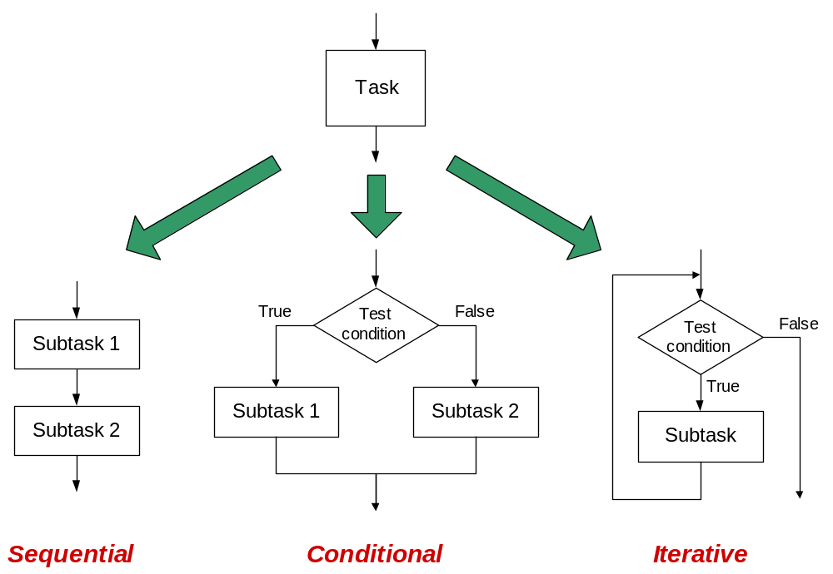
Three Basic Constructs
Coding Assembler

Slide 15
if-then-else
Coding Assembler
if-then-else
cmp.w #1,&buzzerON ;
jne myElse ;
xor.b #0x20,&P4OUT ;
bis.b #0x02,&P1OUT ;
jmp myNext ;
myElse: ;
bic.b #0x02,&P1OUT ;
;
myNext: ;
if (buzzerON == 1)
{
pulse_buzzer();
turn_on_LED();
}
else
{
turn_off_LED();
}

Slide 16
switch / case
Coding Assembler
switch / case
cmp.w #DOT,&myByte ;
jne sw_01 ;
call #do_dot ;
jmp sw_end ;
sw_01:
cmp.w #DASH,&myByte ;
jne default ;
call #do_dash ;
jmp sw_end ;
;
default: ;
sw_end: ;
switch (myByte)
{
case DOT:
do_dot();
break;
case DASH:
do_dash();
break;
default:
}

Slide 17
for-loop
Coding Assembler
for-loop
.bss i,2 ;
mov.w #0,&i ;
for_ck: cmp.w #10,&i ;
jge for_done ;
call #do_dot ;
call #delay ;
call #do_dash ;
call #delay ;
add.w #1,&i ;
jmp fl_ck ;
for_done: ;
int i;
for(i=0; i<10; i++)
{
do_dot();
delay();
do_dash();
delay();
}

Slide 18
while
Coding Assembler
while loop…
TRUE .set 1
.bss blink,2 ;
mov.w #TRUE,&blink ;
while_loop: ;
cmp.w #0,&blink ;
jeq while_done ;
call #LED_ON ;
call #delay ;
call #LED_OFF ;
call #delay ;
jmp while_loop ;
while_done: ;
#define TRUE 1
int blink = TRUE;
while (blink)
{
LED_ON();
delay();
LED_OFF();
delay();
}

